Slide 1

Development-Aware Flood Susceptibility Mapping Using Multi-Temporal Satellite Data
Review 2 — Phase 1: reproducing the base paper on the Lower Periyar basin
BY
2023BCD0005 - ALBIN JOHN
2023BCD0056 - NIKETH B NATH
2023BCD0014 - JATIN NATH
2023BCD0030 - R RANJITH KUMAR
Guided By,
Dr. Rosebell Paul
Indian Institute of Information Technology Kottayam
Notes:
Review 2 covers Phase 1: a full, verified reproduction of the base paper's pipeline on our own study area. Phase 2 (our novel contributions) starts after this review.

Slide 2
From Review 1 to Review 2
Phase 1 reproduces the base paper's logic end to end on the Periyar basin
Stage | Base paper (Mohamadiazar et al., 2024) | Our Phase 1 reproduction
Study area | Miami-Dade, Florida (pluvial) | Lower Periyar & Aluva–Kochi, Kerala (fluvial)
Satellite data | 226 Sentinel-1 images, 2014–2023 | Sentinel-1 VV: 2018, 2019, 2021 flood + dry pairs
Flood inventory | Otsu threshold on VV (SNAP) | Otsu on VV + change detection (Lee filter, GEE)
Inventory check | GTI 84.05 % vs 116 flood reports | GTI 58.4 % vs official NRSC/ISRO NDEM maps
Model | U-Net CNN | LightGBM (tabular, pixel-based)
Output | Flood prediction maps | 5-class susceptibility map + 2019 validation
• Why LightGBM, not U-Net (Step 0): no labelled image set existed for Kerala; building one and tuning a CNN would have used the whole timeline. LightGBM gave a complete, checkable pipeline and matches our Kerala reference papers. U-Net is revisited once Phase 2 has a multi-event inventory.
Indian Institute of Information Technology Kottayam
2
Notes:
The panel will ask why we did not use U-Net. The answer is a deliberate trade-off: no existing labelled data, four weeks, and LightGBM is the method of our Kerala reference papers. Everything else follows the base paper's chain: satellite -> Otsu flood inventory -> ML model -> map -> accuracy metrics.

Slide 3
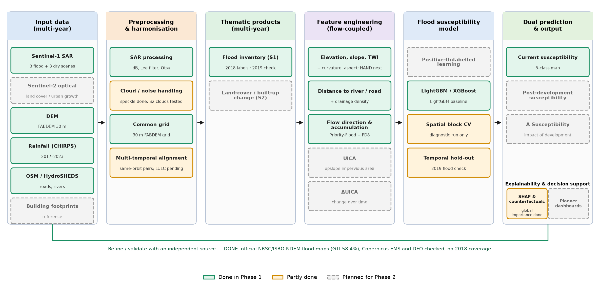
System Architecture — Progress
Review 1 architecture, marked by what Phase 1 has built
Indian Institute of Information Technology Kottayam
3
Notes:
Green = done in Phase 1 (12 blocks), amber = partly done (4), grey dashed = Phase 2 (8). The whole data -> inventory -> features -> model -> current-susceptibility chain works end to end. Everything development-related (Sentinel-2 land cover, UICA/ΔUICA, PU-learning, post-development prediction) is Phase 2 — that is our novelty.

Slide 4
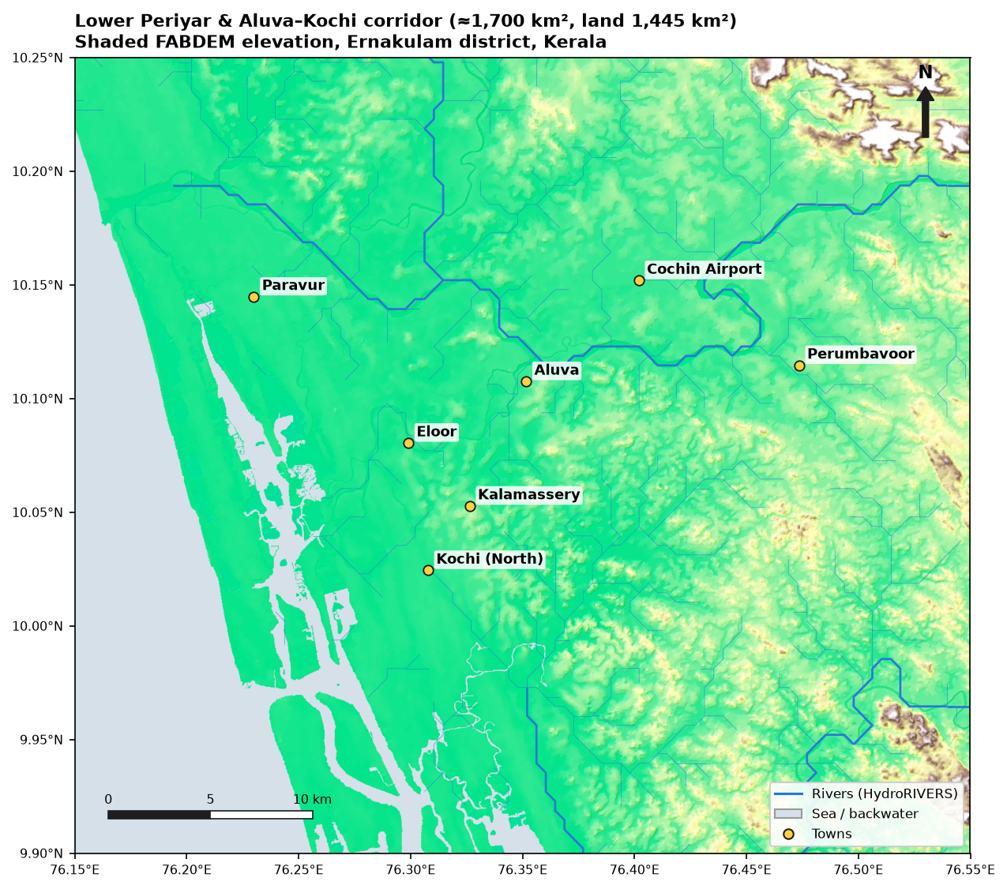
Study Area & Data
Dataset | Source | Resolution
Sentinel-1 VV (flood + dry) | Copernicus / GEE | ~10–20 m
FABDEM elevation | Univ. Bristol / GEE | 30 m
CHIRPS rainfall | UCSB-CHG / GEE | 5.5 km
Rivers (HydroRIVERS) | HydroSHEDS | 15″ network
Roads (OSM drive) | OpenStreetMap | vector
Flood reference | NRSC/ISRO NDEM | polygons
• AOI 76.15–76.55°E, 9.9–10.25°N (≈1,700 km²), UTM 43N
• Contains the Periyar floodplain hit hardest in Aug 2018 and the urbanising Aluva–Kochi corridor
• Soil (NBSS&LUP) not downloadable — same data gap as the base paper's HSG
Indian Institute of Information Technology Kottayam
4
Notes:
The AOI was chosen to contain both the 2018 flood (so the inventory is not empty) and fast urban growth (for Phase 2). All data are open; Sentinel-1, FABDEM and CHIRPS come through Google Earth Engine.

Slide 5
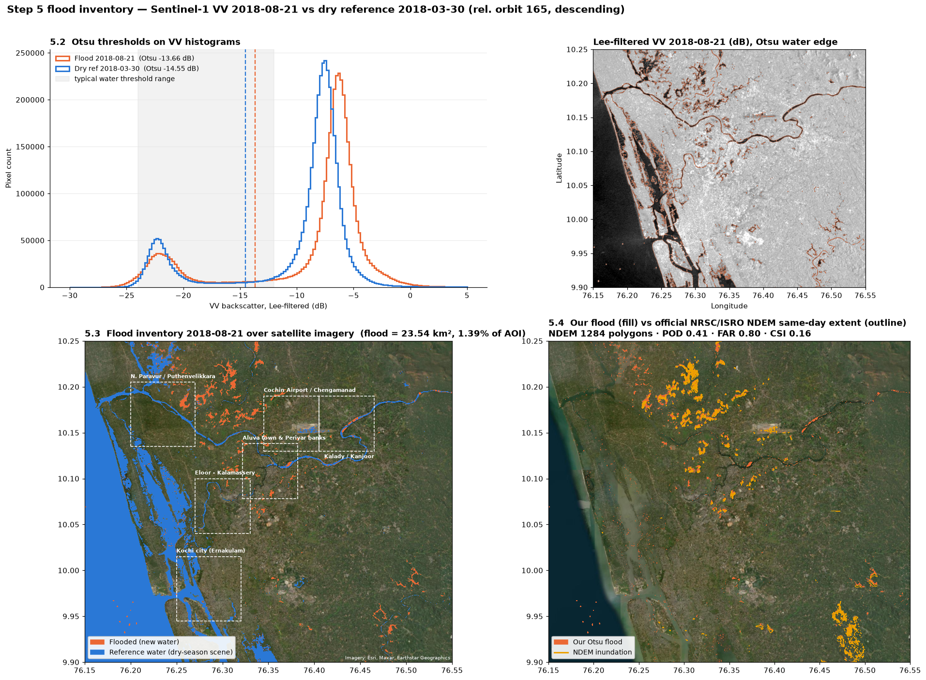
Flood Inventory — Sentinel-1 + Otsu
21 Aug 2018 flood scene vs 30 Mar 2018 dry scene, same orbit
• Base-paper method: backscatter to dB (Eq. 1), Otsu threshold on VV
– Otsu threshold -13.66 dB — sits in the valley between water and land peaks
• Flood = water on flood date AND NOT water in dry scene
– steep slopes (> 5°) and specks (< 5 px) removed
• 2018 flood: 23.5 km² (1.4 % of AOI), on the northern Periyar floodplain
– 2019: 28.9 km² · 2021: 8.9 km² (too small / noisy to use)
• Known blind spots: water among buildings, airport runway, scene is 4–6 days after the peak
Indian Institute of Information Technology Kottayam
5
Notes:
Top left: the two histograms are clearly bimodal and the Otsu threshold falls in the valley, so the threshold is sound. Bottom: flooded pixels (orange) cluster on the Periyar floodplain around Paravur/Puthenvelikkara; Kochi city stays clean. Bottom right: our flood against the official NDEM outline.

Slide 6
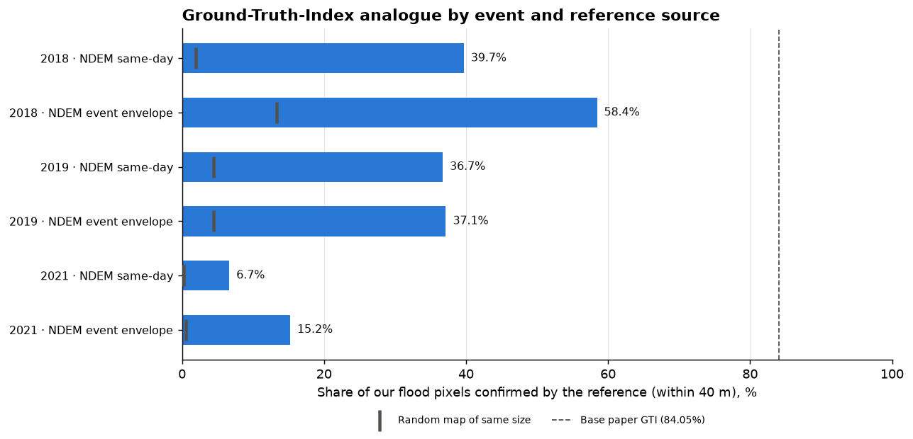
Is the Flood Inventory Right?
Independent check against official NRSC/ISRO NDEM flood maps
• 58.4 % of our 2018 flood pixels confirmed by NDEM (within 40 m)
– strict per-pixel 36.7 % · a random map would score 13.3 % → 4.4× better than chance
– away from river/backwater edges: 74.2 %
• Base paper GTI: 84.05 % (point reports, image taken during the flood)
• Copernicus EMS: no activation · DFO: no 2018 event · Sentinel-2: 82 % cloud
• 2021 fails the check (15 %) → not used as labels
Indian Institute of Information Technology Kottayam
6
Notes:
This is our Ground Truth Index analogue. 58.4 % is lower than the base paper's 84 %, for two measurable reasons: our only scene is 4-6 days after the peak (residual water), and most disagreement sits on the river/backwater fringe. Away from that fringe it rises to 74 %.

Slide 7
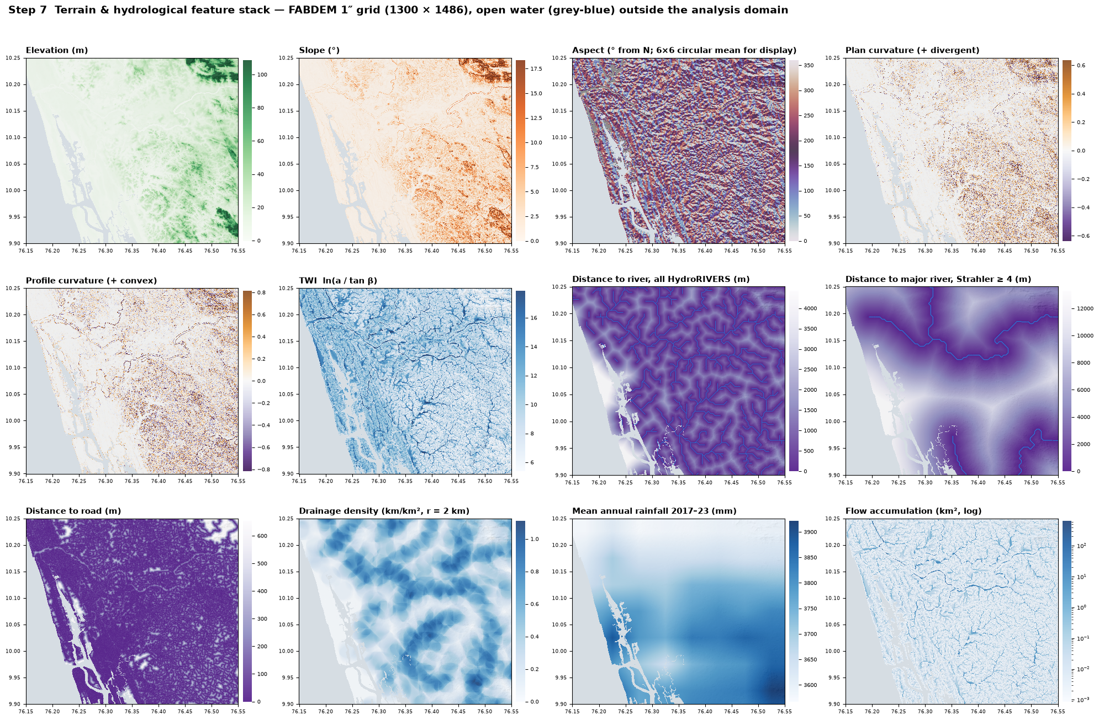
Features & Training Data
11 features on the 30 m FABDEM grid · 30,568 balanced samples
• Terrain: elevation, slope, aspect, plan & profile curvature
• Hydrology: TWI, distance to river / major river, drainage density
• Distance to road, mean annual rainfall
– all layers on one grid, no gaps, 11 self-tests passed; max VIF 2.4
• 15,284 flood + 15,284 non-flood samples (2018)
– flood = Otsu flood confirmed by NDEM; non-flood = away from any observed flood and the NDEM envelope
– no feature derived from Sentinel-1 → no label leakage
Indian Institute of Information Technology Kottayam
7
Notes:
Only the reliable part of the inventory becomes training data: flood pixels confirmed by NDEM, and non-flood pixels far from anything that flooded at the peak. None of the features comes from the radar image, so the model cannot cheat by reading the label.

Slide 8
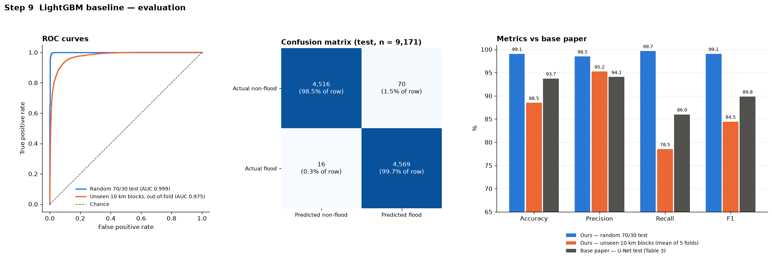
Model Results — Metrics
LightGBM baseline vs base paper
Evaluation | Accuracy | Precision | Recall | F1 | AUC
Ours — random 70/30 split (plan method) | 99.1% | 98.5% | 99.7% | 99.1% | 0.999
Ours — unseen 10 km regions (honest) | 88.5% | 95.2% | 78.5% | 84.5% | 0.979
Base paper — U-Net test | 93.73% | 94.07% | 86.00% | 89.85% | 0.93
• 99 % looks too good — we checked why: 98.7% of flood test pixels sit next to a training pixel
• Not leakage: on whole regions never seen, accuracy is 88.5%
• Hard case (flat floodplain only): AUC 0.935
Indian Institute of Information Technology Kottayam
8
Notes:
The plan warns that ~0.999 AUC usually means leakage, so we investigated. The random split tests on neighbours of training pixels. Holding out whole 10 km regions gives 88.5 % accuracy, which is our honest number and comparable to the base paper's 93.7 %. AUC stays about 0.98, so the model ranks terrain well.

Slide 9
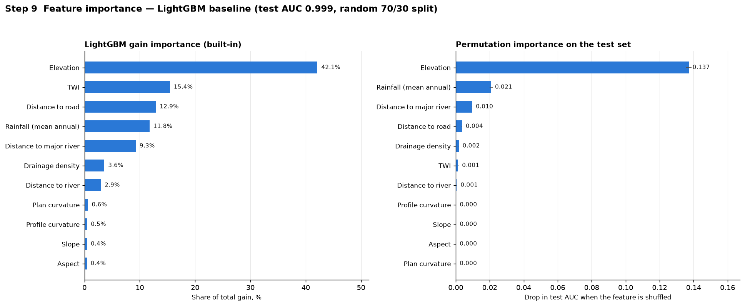
What Drives the Model?
Feature importance and an input ablation like base-paper Table 4
• Elevation dominates (42 % of gain), then TWI, distance to road, rainfall, distance to major river
• Base-paper Table 4 is an input ablation (slope, soil, imperviousness, rainfall), not a ranking — so we ran the same
– agrees: more inputs help; rainfall alone is weakest
– rainfall only works as a location label: 55.1% on unseen regions ≈ chance
• Imperviousness (base paper's key input) has no counterpart yet → Phase 2 UICA
Inputs | Random-split acc. | Unseen-region acc.
All 11 features | 99.1% | 88.5%
Without terrain | 98.1% | 78.9%
Without rainfall | 98.2% | 89.7%
Rainfall only | 73.9% | 55.1%
Indian Institute of Information Technology Kottayam
9
Notes:
Elevation is the strongest factor, as expected for river flooding on a coastal floodplain. The base paper's Table 4 retrains the model with fewer inputs; our version of that table shows terrain matters most for new regions and rainfall does not really transfer. The missing imperviousness input is exactly our Phase 2 contribution.

Slide 10
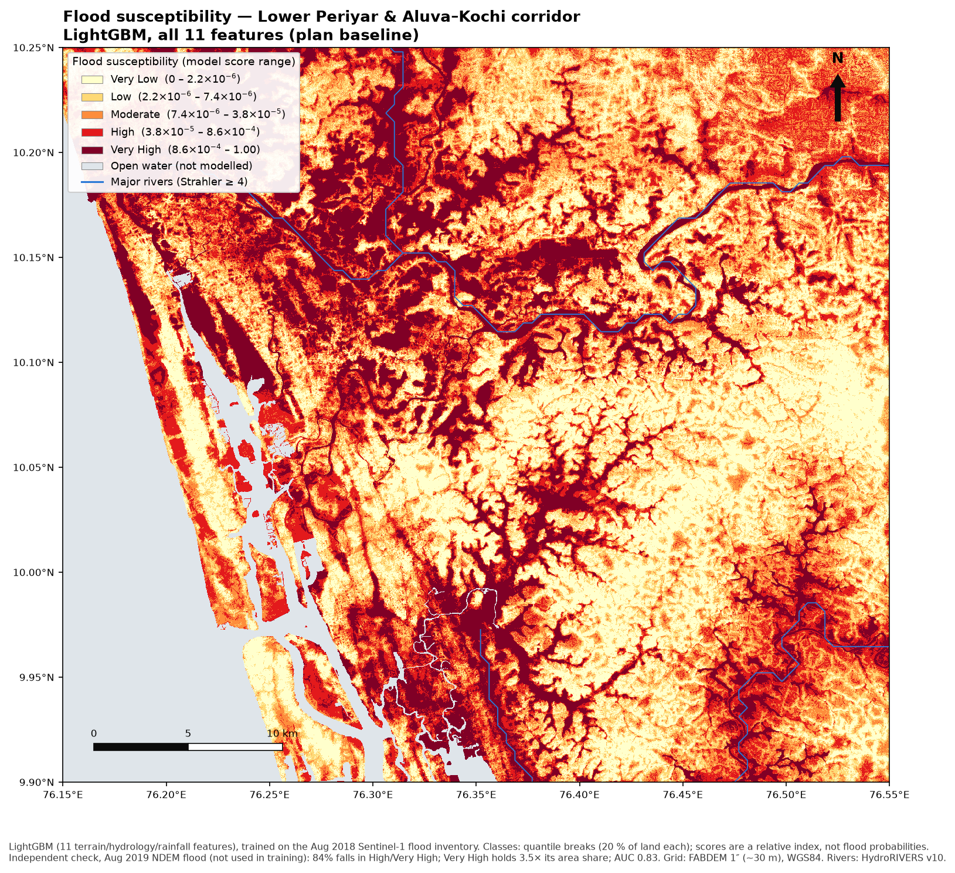
Flood Susceptibility Map
Model applied to all 1.64 million land pixels · 5 quantile classes
• Tested on a flood the model never saw — Aug 2019 (NDEM):
– 83.8% of the 2019 flood falls in High / Very High (40 % of land)
– Very High class holds 3.5× its area share; AUC 0.83
– even where 2018 did not flood: AUC 0.78
• High susceptibility follows the Periyar floodplain, valleys and low coastal land
• Scores are a relative index (balanced training), not flood probabilities
– only Very High is strongly predictive; High is near chance
Indian Institute of Information Technology Kottayam
10
Notes:
This is the main Phase 1 deliverable. The key evidence is the 2019 check: the model was trained on 2018 only, yet 84 % of the official 2019 flood falls in our top two classes, which cover 40 % of the land.

Slide 11
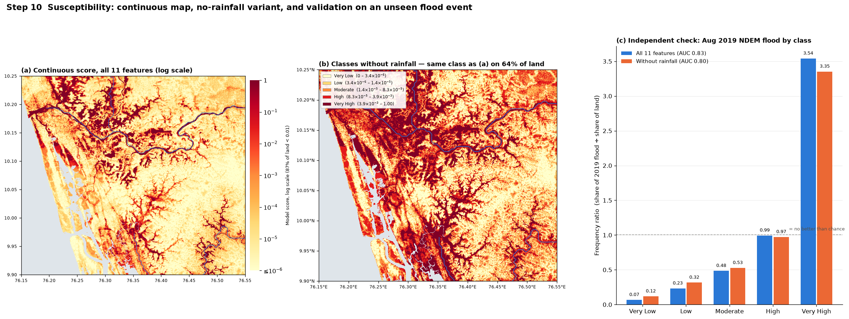
Finding: Coarse Rainfall Acts as a Location Label
Same model with and without CHIRPS rainfall
 | With rainfall | Without rainfall
2019 flood AUC | 0.83 | 0.80
Land > 50 m rated High / Very High | 23.4% | 13.4%
Unseen-region accuracy | 88.5% | 89.7%
• 5.5 km CHIRPS cells imprint rectangles on the hills (panel a, top right)
• Phase 2: event rainfall at higher resolution
Indian Institute of Information Technology Kottayam
11
Notes:
Rainfall here barely varies (about 10 % across 60 coarse cells), so the model uses it to recognise where the 2018 flood was, not how much it rained. Without it the map is physically cleaner at a small cost on 2019. We show both maps.

Slide 12
Known Limitations → Phase 2
Stated deliberately: where Phase 1 ends and our contribution begins
Phase 1 limitation | Measured effect | Phase 2 remedy
Random 70/30 split | 99.1% vs 88.5% on unseen regions | Spatial block CV + temporal hold-out
Non-flood = 'not seen flooded' | Urban floods invisible to SAR count as dry | Positive-Unlabelled learning
No land-use / imperviousness | Model is development-blind | UICA / ΔUICA features
One post-peak flood event | Residual extent only (23.5 of 75 km²) | Multi-event, multi-orbit inventory
LightGBM, pixel-based | No spatial context | Revisit U-Net on larger inventory
Coarse rainfall | Location proxy, map artifact | Event rainfall, higher resolution
Current conditions only | No development scenarios | Dual current vs post-development prediction
Indian Institute of Information Technology Kottayam
12
Notes:
These are not weaknesses to hide: each one is measured, and each maps directly onto a Phase 2 component from our Review 1 novelty slide. Full detail is in docs/limitations.md.

Slide 13
Conclusion
• Phase 1 complete: satellite → flood inventory → features → model → susceptibility map → metrics, reproduced end to end on the Periyar basin
• Flood inventory verified against official NDEM maps (GTI 58.4 %, 4.4× chance)
• Baseline model: 99.1% on the reference-paper split, 88.5% on unseen regions (base paper 93.73 %)
• Susceptibility map predicts an unseen flood: 83.8% of 2019 flood in High / Very High
• Every step documented, verified and version-controlled
• Next (Phase 2): UICA / ΔUICA · PU-learning · spatial CV · multi-event inventory · current vs post-development prediction
Indian Institute of Information Technology Kottayam
13
Notes:
One-line summary: the full base-paper pipeline now works on our study area, its numbers are verified honestly, and every gap maps onto a planned Phase 2 contribution.

Slide 14
Anticipated Questions
Backup slide
Q: Why LightGBM and not U-Net?
A: No labelled image set; CNN pipeline would take the whole timeline. LightGBM = full verified chain; U-Net revisited in Phase 2.
Q: How do you know the flood map is correct?
A: 58.4 % confirmed by official NDEM maps (4.4× chance); 83.8% of the unseen 2019 flood in our top classes.
Q: Is 99 % accuracy real or overfitting?
A: Random-split optimism from neighbouring pixels. On unseen regions: 88.5%. Spatial CV becomes the Phase 2 standard.
Q: Why is your GTI lower than 84 %?
A: Only scene is 4–6 days after the peak; disagreement is on water edges (74 % away from them).
Q: What is left to do?
A: UICA / ΔUICA, PU-learning, spatial CV, more flood events, dual prediction, SHAP.
Indian Institute of Information Technology Kottayam
14
Notes:
Keep this slide hidden until asked. The longer answers are in docs/review2_materials.md.

Slide 15
References
[1] N. Mohamadiazar, A. Ebrahimian, H. Hosseiny, "Integrating deep learning, satellite image processing, and spatial-temporal analysis for urban flood prediction," J. Hydrology, vol. 639, 131508, 2024.
[2] L. Hawker et al., "A 30 m global map of elevation with forests and buildings removed (FABDEM)," Environ. Res. Lett., vol. 17, 024016, 2022.
[3] C. Funk et al., "The climate hazards infrared precipitation with stations (CHIRPS)," Sci. Data, vol. 2, 150066, 2015.
[4] B. Lehner, G. Grill, "Global river hydrography and network routing (HydroSHEDS)," Hydrol. Process., vol. 27, 2013.
[5] N. Otsu, "A threshold selection method from gray-level histograms," IEEE Trans. SMC, vol. 9, 1979.
[6] R. Barnes, C. Lehman, D. Mulla, "Priority-flood: an optimal depression-filling and watershed-labeling algorithm," Comput. Geosci., vol. 62, 2014.
[7] P. Quinn et al., "The prediction of hillslope flow paths for distributed hydrological modelling using digital terrain models," Hydrol. Process., vol. 5, 1991.
[8] G. Ke et al., "LightGBM: a highly efficient gradient boosting decision tree," NeurIPS, 2017.
[9] NRSC/ISRO, National Database for Emergency Management (NDEM), Kerala flood inundation layers, 2018–2021.
Indian Institute of Information Technology Kottayam
15
Notes:
Base paper [1]; data sources [2]-[4], [9]; methods [5]-[8]. The Review 1 literature references still apply.

